Slide 1
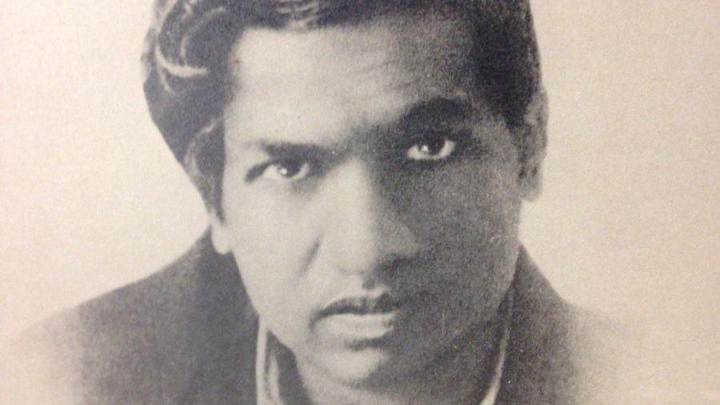
On the Nature of Numbers
Prof. Darrell Long
CSE 13S
Srinivasa Ramanujan
Numbers were his friends

Slide 2
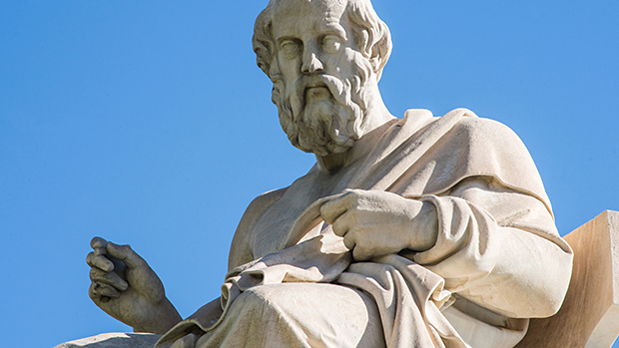
Is God a mathematician?
Pythagoras believed that only numbers exist, and all emanated from numbers.
Plato believed that that there are abstract mathematical objects whose existence is independent of us and our language, thought, and practices.
Did we create numbers or do numbers exist independent of us?
Certainly, numbers exist independent of how we choose to represent them.
All of Computer Science is about the manipulation of numbers.
“The Unreasonable Effectiveness of Mathematics in the Natural Sciences” —Eugene Wigner, 1960

Slide 3
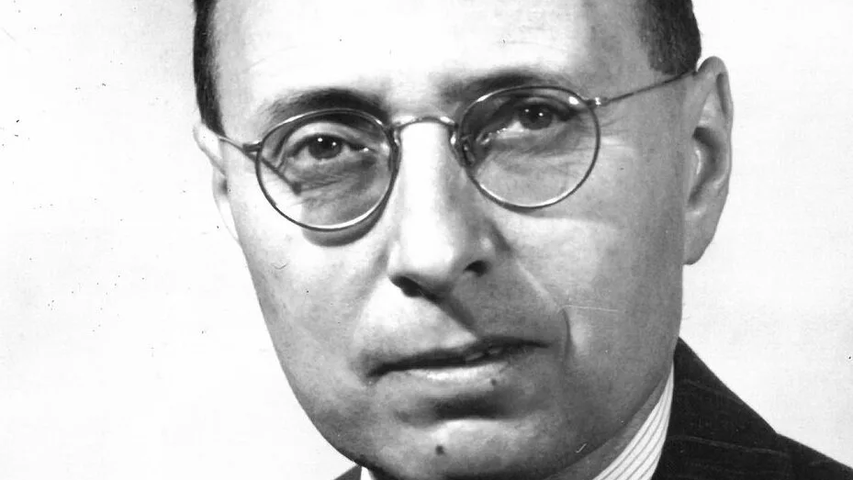
Why is mathenmatics so effective?
The miracle of the appropriateness of the language of mathematics for the formulation of the laws of physics is a wonderful gift which we neither understand nor deserve. We should be grateful for it and hope that it will remain valid in future research and that it will extend, for better or for worse, to our pleasure, even though perhaps also to our bafflement, to wide branches of learning.
—Eugene Wigner

Slide 4
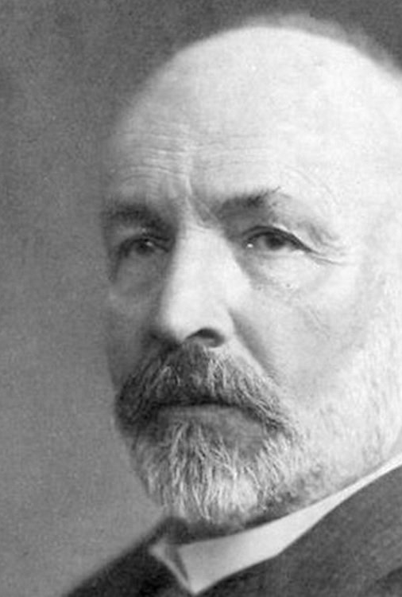
On the nature of Numbers
We all think that we know what a number is:
1, 3, 5, 7, 11, … are all numbers, right?
Not quite, they are the representation of numbers.
You cannot hold a number in your hand.
Numbers exist independently of their representation.
There are many ways to write the same number.
Our method for writing numbers derives from the Hindu-Arabic numeral system:
Aryabhata (आर्यभट) introduced positional notation, and Brahmagupta introduced the notion of zero.
We write our numbers base 10 since most of us have 10 fingers.
The ancient Babylonians used base 60, which is why we have 60 seconds in a minute, 60 minutes in an hour.
Georg Cantor
The Continuum Hypothesis drove him mad

Slide 5
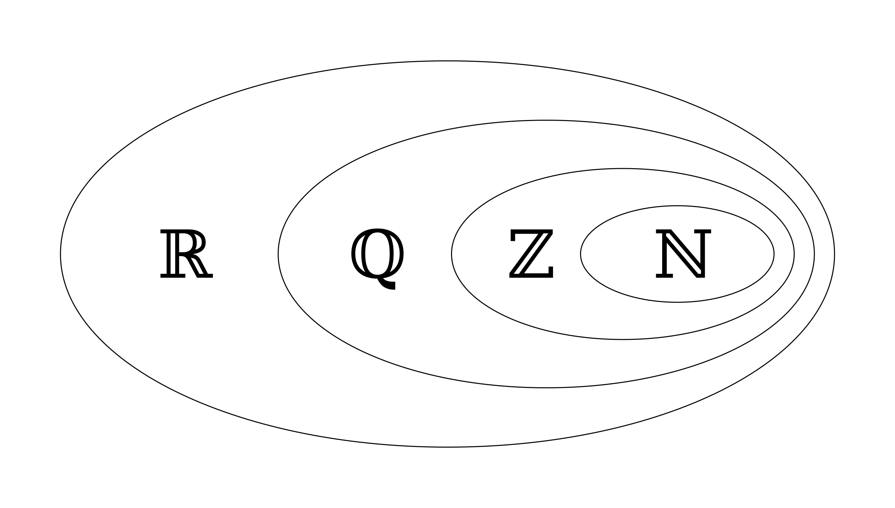

Kinds of Numbers
$ℕ=\{1, 2, 3, …\}$
$ℤ=\{…, −3, −2, −1, 0, 1, 2, 3, …\}$
$ℚ=\{\frac{a}{b}:a, b∈ℤ\}$
$ℝ=ℚ∪the irrational numbers$
$ℂ=ℝ∪$ the imaginary numbers
$π, e, γ, φ$ are all irrational, and are much more numerous than $ℚ$.
Imaginary allows $i=\sqrt{−1}$, and so complex is $(a+bi)$, $a,b∈ℝ$.

Slide 6
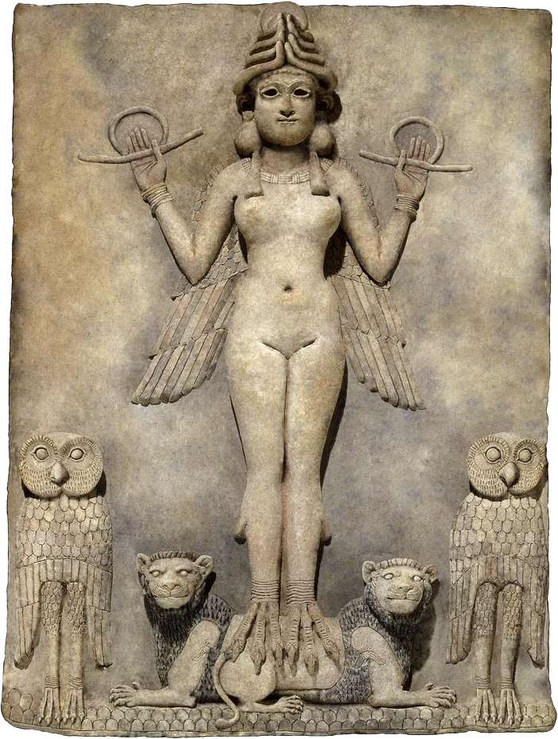
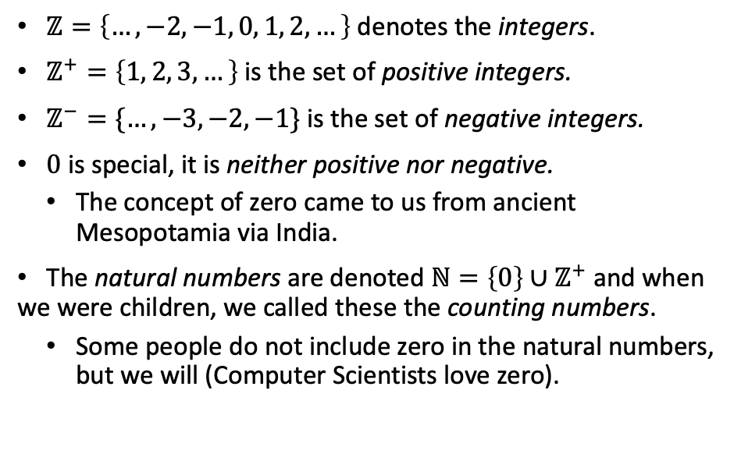
Integers and Natural Numbers
“Queen of the Night” (Ishtar)
Babylon 1800–1720 BC
$ℤ=\left\{…, −2, −1, 0, 1, 2, …\right\}$ denotes the integers.
$ℤ^{+}=\left\{1, 2, 3, …\right\}$ is the set of positive integers.
$ℤ^{−}=\{…, −3, −2, −1\}$ is the set of negative integers.
$0$ is special, it is neither positive nor negative.
The concept of zero came to us from ancient Mesopotamia via India.
The natural numbers are denoted $ℕ=\left\{0\right\}∪ℤ^{+}$ and when we were children, we called these the counting numbers.
Some people do not include zero in the natural numbers, but we will (Computer Scientists love zero).
Die ganzen Zahlen hat der liebe Gott gemacht, alles andere ist Menschenwerk.
—Leopold Kronecker

Slide 7
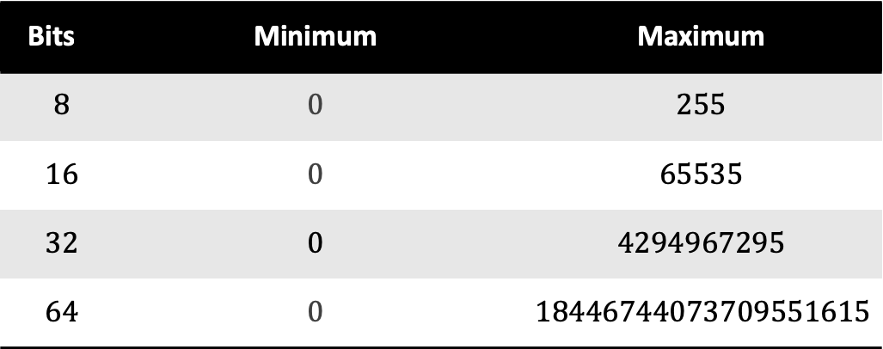
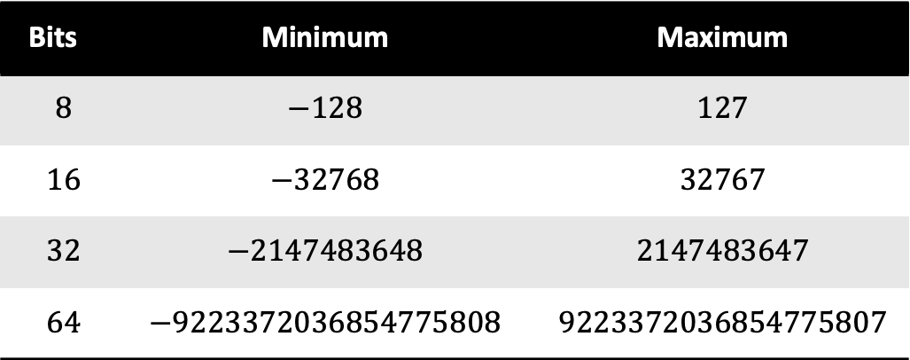
Computers can represent none of those sets
Bits | Minimum | Maximum
$$8$$ | $$−128$$ | $$127$$
$$16$$ | $$−32768$$ | $$32767$$
$$32$$ | $$−2147483648$$ | $$2147483647$$
$$64$$ | $$−9223372036854775808$$ | $$9223372036854775807$$
Computers do arithmetic in finite fields.
Which means they have a large, but finite, set of numbers that they can represent.
It’s like saying you can only do arithmetic up to 10 digits.
A digit for a computer is usually called a bit.
A bit is either 0 or 1.
Bits | Minimum | Maximum
$$8$$ | $$0$$ | $$255$$
$$16$$ | $$0$$ | $$65535$$
$$32$$ | $$0$$ | $$4294967295$$
$$64$$ | $$0$$ | $$18446744073709551615$$

Slide 8



Positional Number Systems
Aryabhata (आर्यभट) taught us that every member of $ℕ$ can be written:
$a_{k}b^{k}+a_{k−1}b^{k−1}+…+a_{1}b^{1}+a_{0}b^{0}$
$b$ is the base, be it 2, 8, 10 (our usual base), 16, …
$a_{i}∈\{0, …, b−1\}$
$$1962 =1 {×10}^{3}+9×{10}^{2}+6×{10}^{1}+2×{10}^{0}$$
$=$ ${7AA}_{16}={3652}_{8}$ $={2200200}_{3}$
$={11110101010}_{2}$
Those all represent the same number.
The answer to the ultimate question is $42$.
The ultimate question is: What is $6 × 9$?
It’s true, since $6 × 9 = 54 ={42}_{13}$.

Slide 9
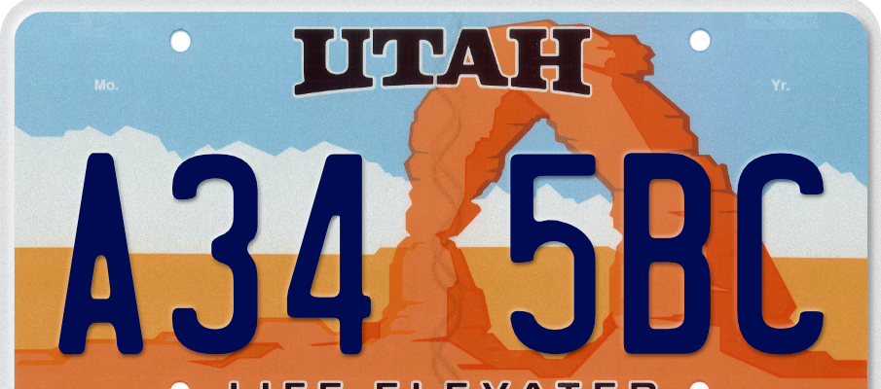

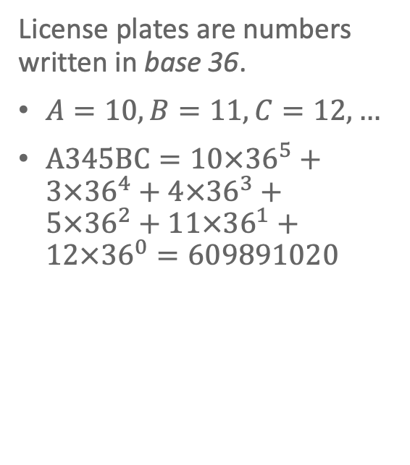
License Plates
License plates are numbers written in base 36.
$A=10,B=11, C=12, …$
$A345BC=10×{36}^{5}+3×{36}^{4}+4×{36}^{3}+5×{36}^{2}+11×{36}^{1}+12×{36}^{0}=609891020$

Slide 10
Specifying an Integer in C
char
unsigned char
int
unsigned int
short int
unsigned short int
long int
unsigned long int
long long int
unsigned long long int
short
long
long long
unsigned
int
unsigned
char

Slide 11
C Integer Data Types
Name | Size
char | Usually 8 bits
short | Usually 16 bits
int | At least 16 bits
long | At least 32 bits
long long | Probably 64 bits

Slide 12
#include <stdint.h>
Signed | Unsigned | Size
int8_t | uint8_t | 8 bits
int16_t | uint16_t | 16 bits
int32_t | uint32_t | 32 bits
int64_t | uint64_t | 64 bits

Slide 13
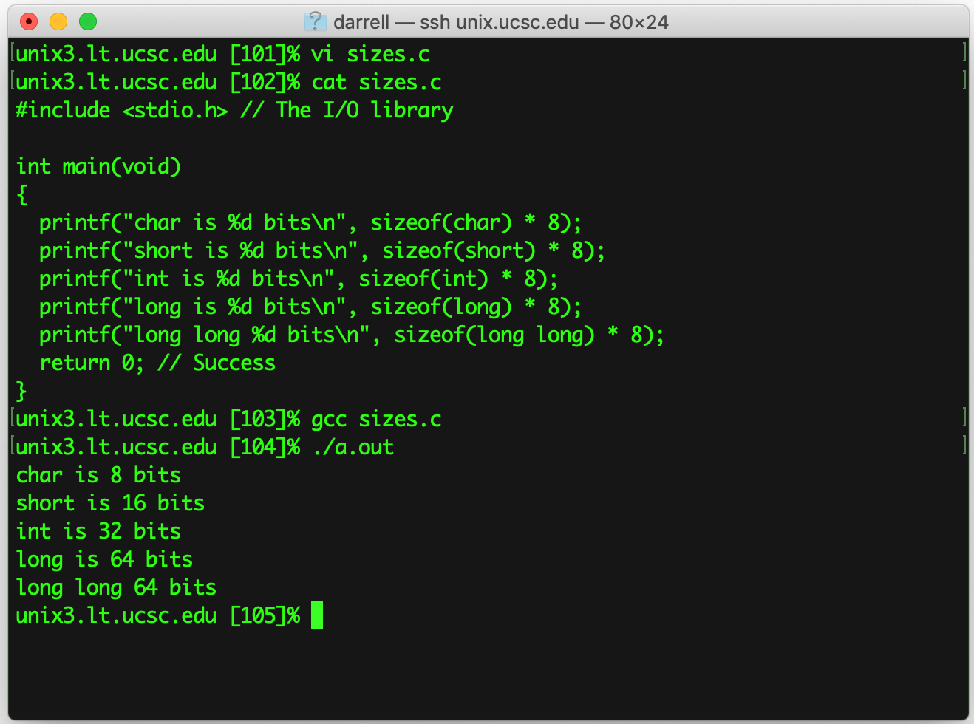
Let’s ask Linux!
Standard I/O
Print to the screen
How many bytes?
Bytes have 8 bits

Slide 14
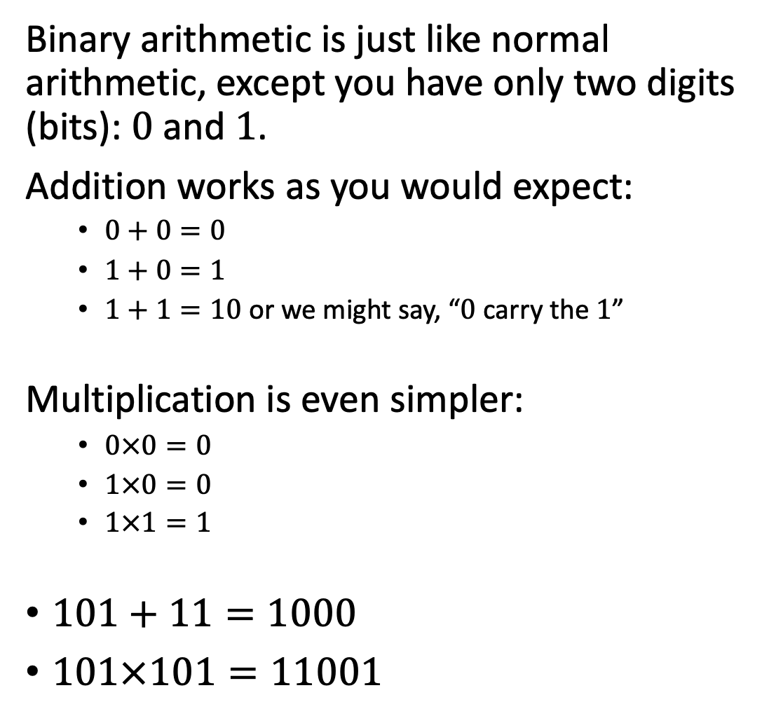
Binary Arithmetic
Binary arithmetic is just like normal arithmetic, except you have only two digits (bits): $0$ and $1$.
Addition works as you would expect:
$0+0=0$
$1+0=1$
$1+1=10$ or we might say, “$0$ carry the $1$”
Multiplication is even simpler:
$0×0=0$
$1×0=0$
$1×1=1$
$101+11=1000$
$101×101=11001$
+ | 0 | 1
0 | 0 | 1
1 | 1 | 10
× | 0 | 1
0 | 0 | 0
1 | 0 | 1

Slide 15

Arithmetic in a Finite Field
Computers have fixed width integers, typically 8, 16, 32, and 64 bits.
You’ve seen the limits of those sizes.
How do we implement negative numbers?
We could do arithmetic like humans do, but there’s an easier way.
In a finite field we can define for every number its additive inverse.
If $i$ is a number in a finite field, and $\overline{i}$ its additive inverse then $i+\overline{i}=0.$
Suppose that we have $k$ bits, then we can have every positive integer from $0$ to $2^{k}−1$.
We can use one half of those as additive inverses and so our numbers range from $−2^{k−1}$ to $2^{k−1}−1.$

Slide 16

Two’s Complement Arithmetic
Positive | Negative
0000 | 0000
0001 | 1111
0010 | 1110
0011 | 1101
0100 | 1100
0101 | 1011
0110 | 1010
0111 | 1001
To get the additive inverse of a number m,
Flip the bits in m, $0→1$ and $1→0$ (in C this is the ~ operator), and then
Add one to the result.
Let’s try $5={0101}_{2}$ using 4 bit integers:
$\sim {0101}_{2}+1={1010}_{2}+1={1011}_{2}$
${0101}_{2}+{1011}_{2}={10000}_{2}$ but we only have four bits, so we drop the high-order (carry) bit and get ${0000}_{2}$.

Slide 17
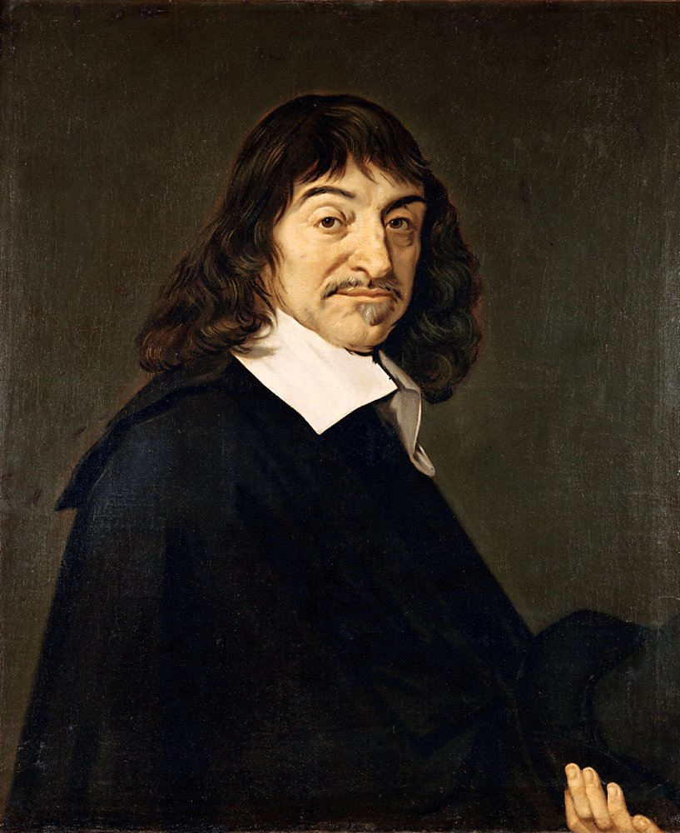
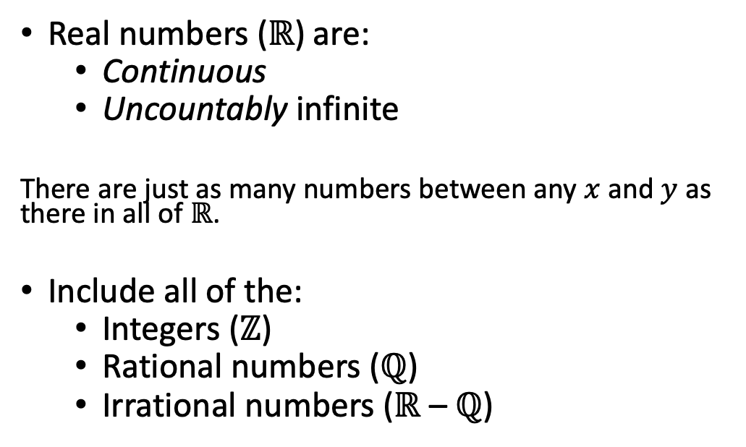
Real Numbers
Real numbers (ℝ) are:
Continuous
Uncountably infinite
There are just as many numbers between any $x$ and $y$ as there in all of ℝ.
Include all of the:
Integers (ℤ)
Rational numbers (ℚ)
Irrational numbers (ℝ – ℚ)
René Descartes

Slide 18
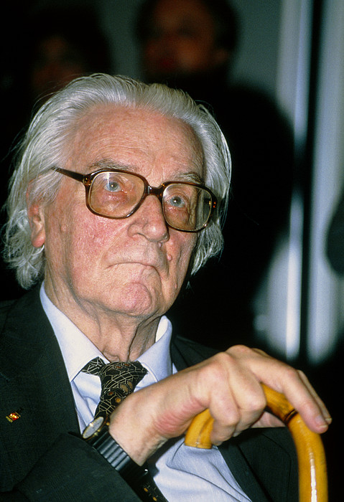
Floating Point Numbers
Are a proper subset of real numbers:
𝔽 ⊊ ℝ
Are a proper subset of rational numbers:
𝔽 ⊊ ℚ
Are a proper subset of the integers:
𝔽 ⊊ ℤ
It’s a mistake to think of them as reals.
It is a mistake to think of them as rationals.
They are an approximation.
Konrad Zuse

Slide 19
Floating Point Numbers
C Specification | C Name | Implementation | Bits
float | Single Precision | IEEE 754 Single | 32
double | Double Precision | IEEE 754 Double | 64
long double | Extended Precision | IEEE 754 Quad | 128

Slide 20


Decimal and Binary Fractions
$\frac{2}{5}=\frac{4}{10}=0.4=4×{10}^{−1}$ which is exact.
$\frac{1}{3}=0.333333…$ which repeats forever.
There is no power of $10$ that divides evenly by $3.$
The fundamental theorem of arithmetic states every $n∈\text{ℕ}$ has a unique prime factorization.
${10}^{k}=2^{k}5^{k}$ and none of those factors is $3.$
Can we write $\frac{1}{10}$ exactly using binary fractions?
$$a_{1}2^{−1}+…+a_{k}2^{−k}=2^{−k}\sum_{i=1}^{k}{a_{i}2^{k−i}}$$
$2^{k}=2×…×2$, none of which is $5$, and when we factor $10=2×5$.
So, $0.1$ cannot be represented exactly on a digital computer in floating point format.
float$≠ℚ$

Slide 21
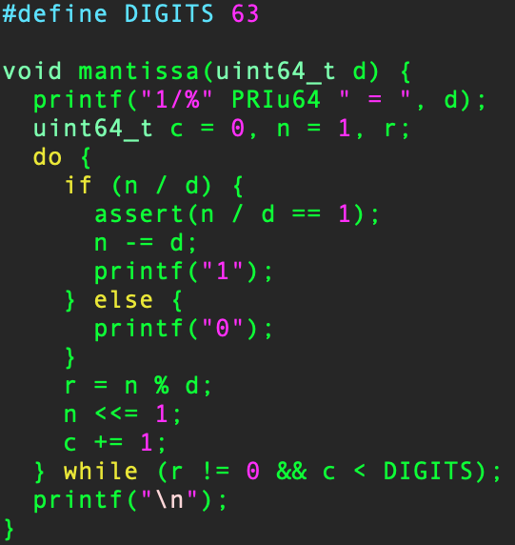
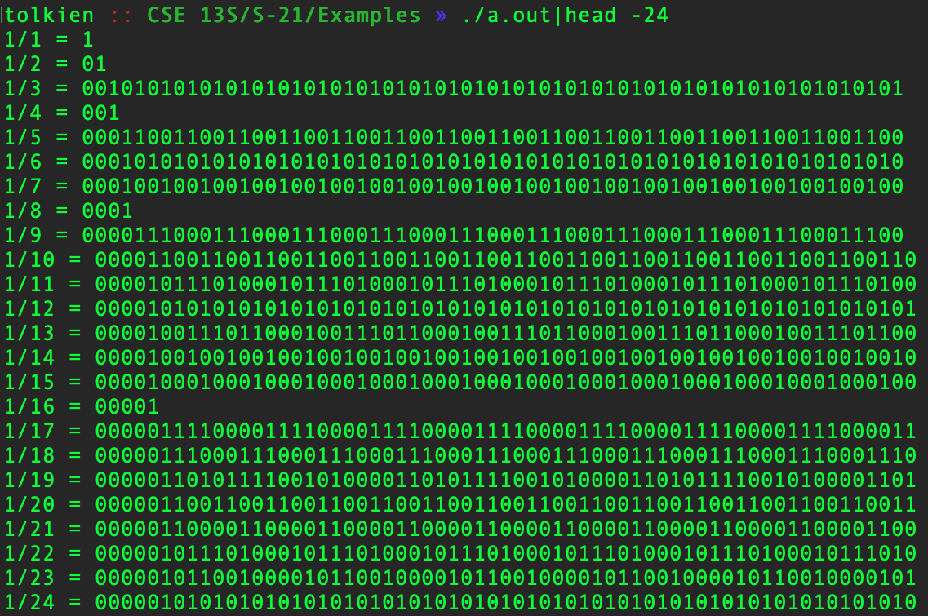
Binary Fractions

Slide 22
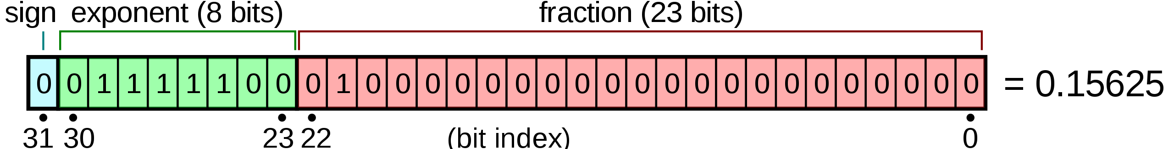
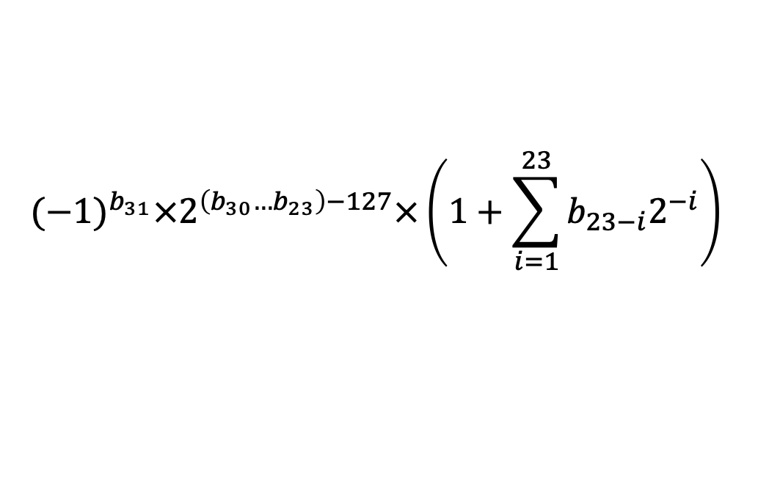
Single Precision
$${(−1)}^{b_{31}}×2^{\left(b_{30}…b_{23}\right)−127}×\left(1+\sum_{i=1}^{23}{b_{23−i}2^{−i}}\right)$$
What we are doing is what you learned as scientific notation in high school.
Notes:
Credit: Wikipedia

Slide 23
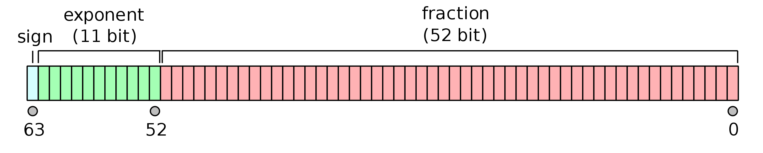
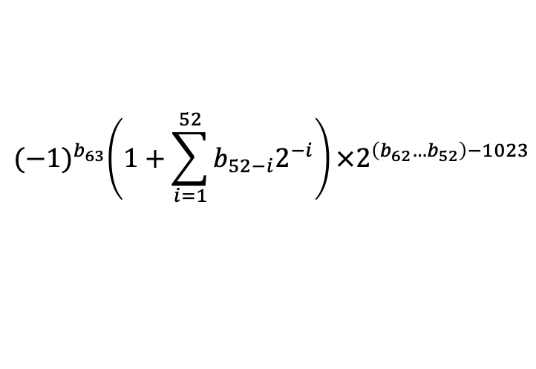
Double Precision
$${(−1)}^{b_{63}}\left(1+\sum_{i=1}^{52}{b_{52−i}2^{−i}}\right)×2^{\left(b_{62}…b_{52}\right)−1023}$$

Slide 24
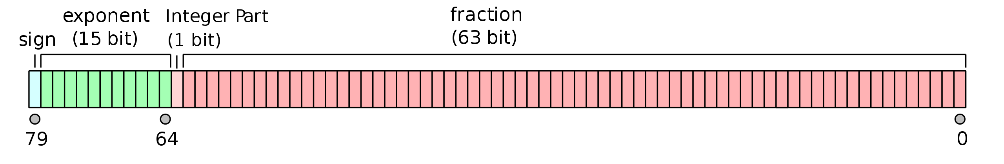
Intel Extended Precision
This format is Intel only, and you should avoid it if you want your results to be portable to other computers.

Slide 25
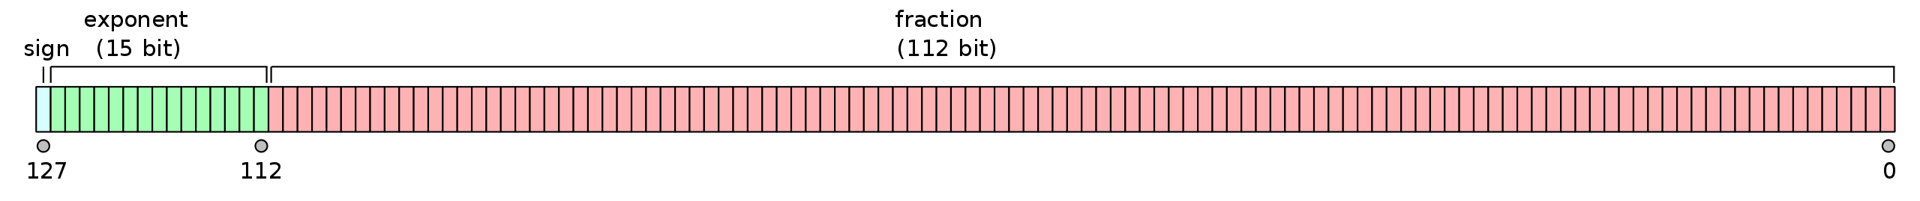
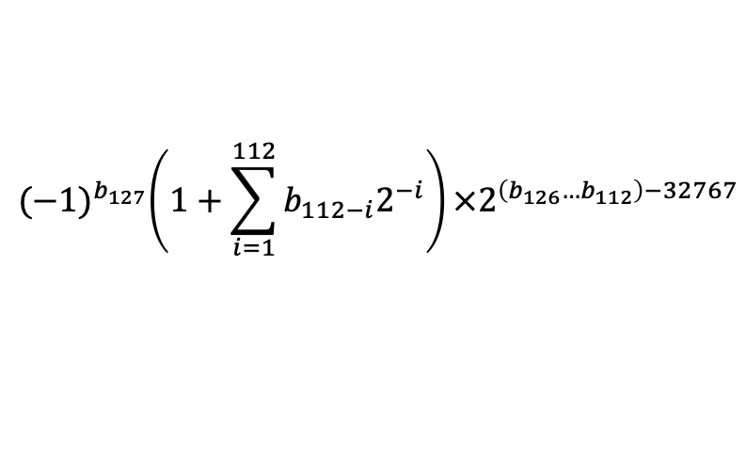
Quad Precision
$${(−1)}^{b_{127}}\left(1+\sum_{i=1}^{112}{b_{112−i}2^{−i}}\right)×2^{\left(b_{126}…b_{112}\right)−32767}$$

Slide 26
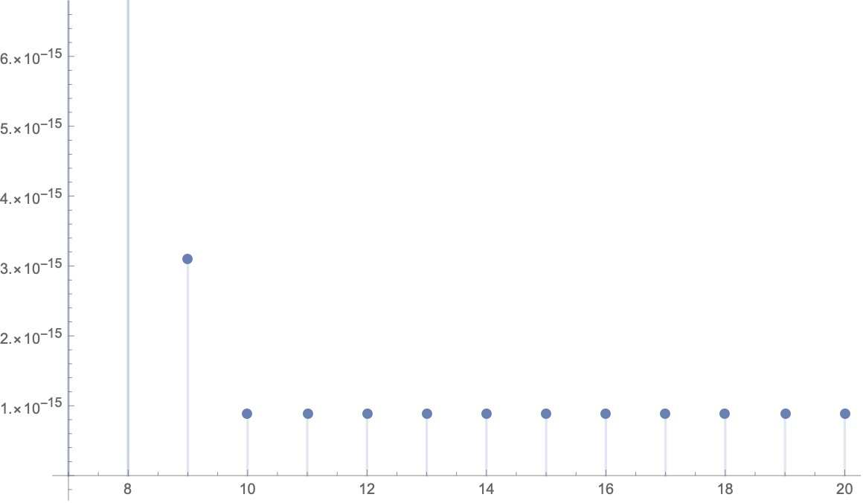
There are limits to floating point precision!
float
8-bit exponent
23-bit mantissa
double
11-bit exponent
52-bit mantissa
long double
15-bit exponent
112-bit mantissa

Slide 27
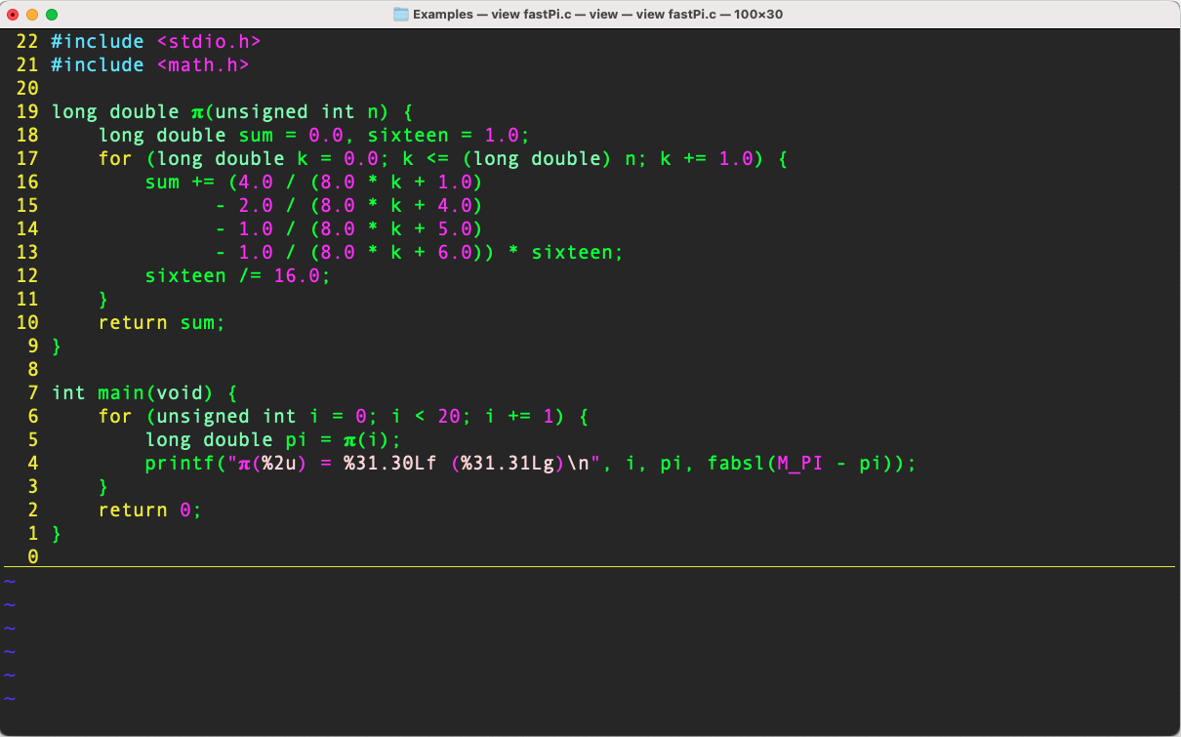
Let’s compute 𝛑

Slide 28
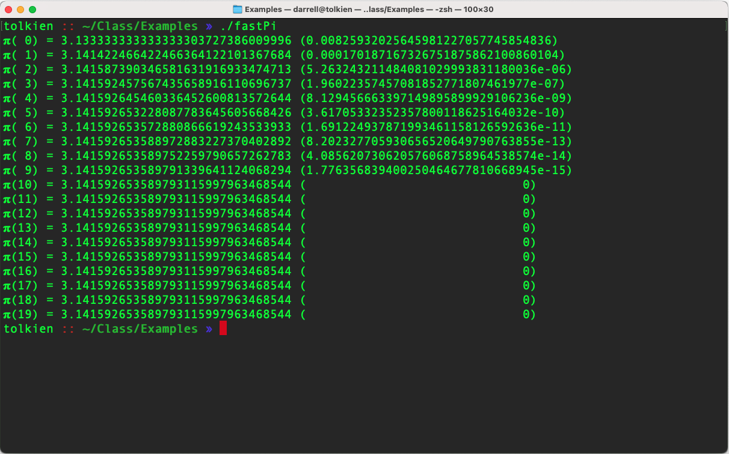
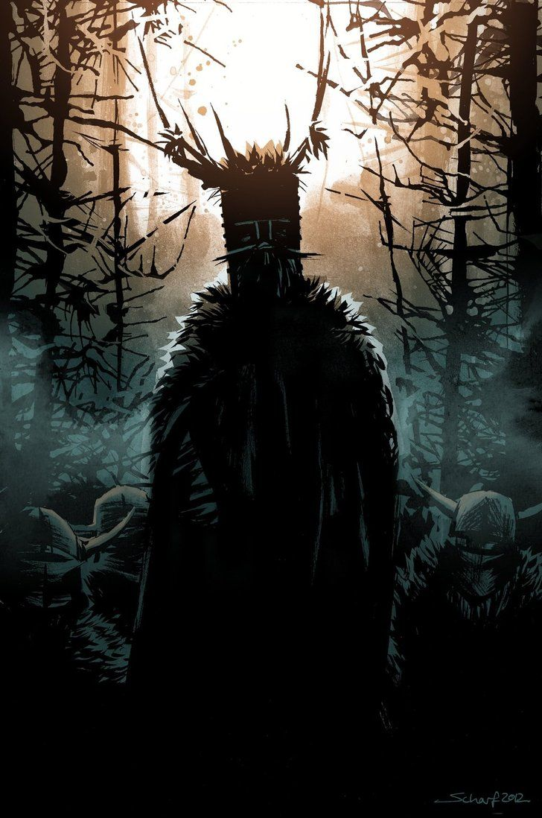
What happened?

Slide 29
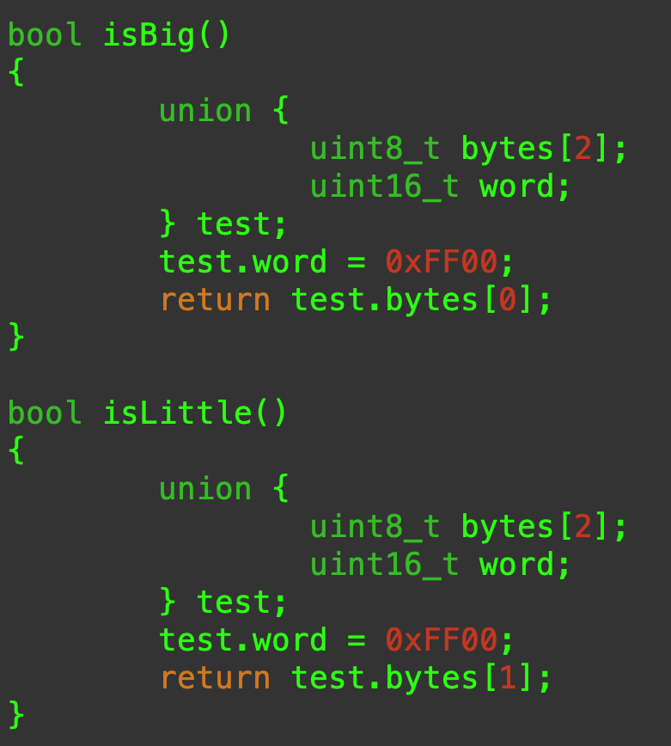
Big endian, little endian
When we have an integer that requires multiple bytes, what is the address of the byte holding the least significant bit?
Little Endian means it is the low address byte.
Big Endian means it is the high address byte.
You can ask the same question about the most significant bit.
Most of the time you do not care, unless you are communicating with a computer that uses the other convention.

Slide 30
Big Endian versus Little Endian
Big Endian
Little Endian
1 2 | 3 4 | 5 6 | 7 8
7 8 | 5 6 | 3 4 | 1 2

Slide 31
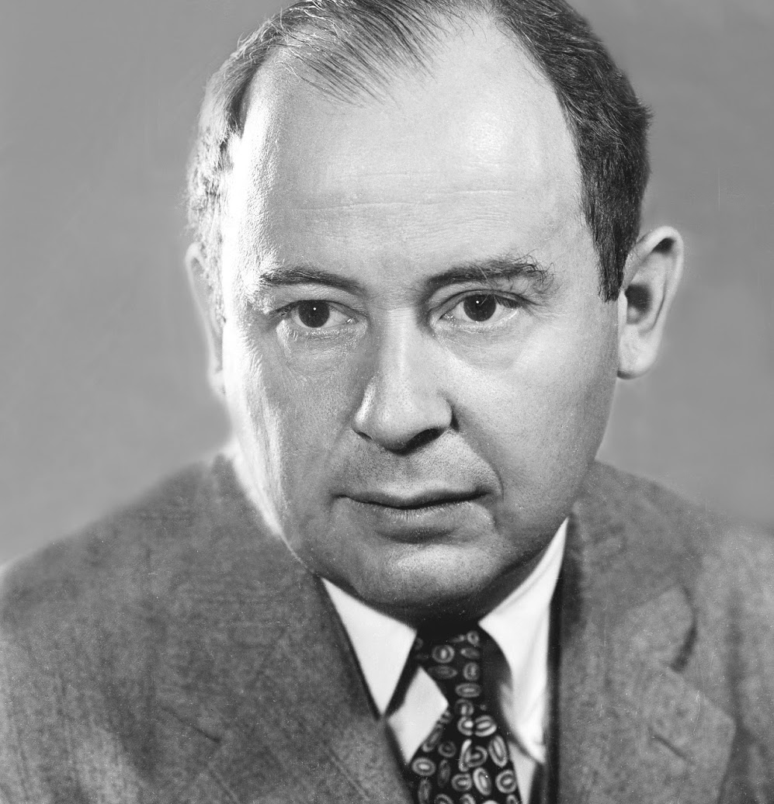
Random Numbers
Anyone who considers arithmetical methods of producing random digits is, of course, in a state of sin. —John von Neumann
True random numbers cannot be created using computers.
Why?
Programs are inherently deterministic.
It has the advantage of repeatability, but
It has the disadvantage of predictability.
John von Neumann

Slide 32
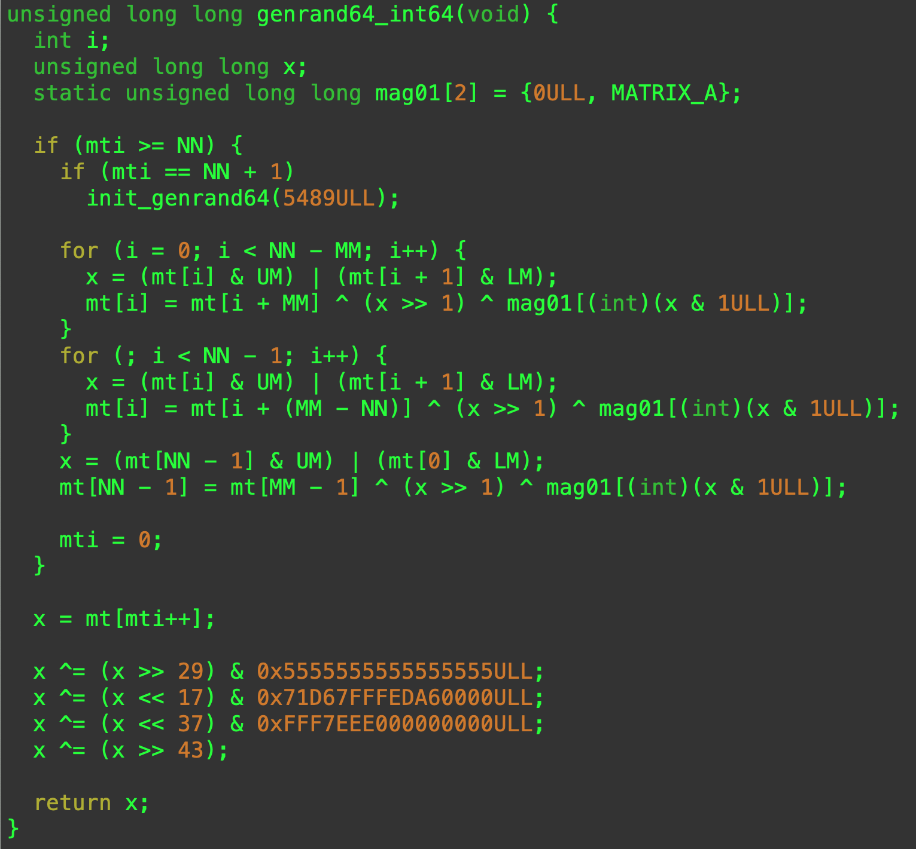
Mersenne Twister
A state of the art pseudorandom number generator
❦
But does it generate random numbers?

Slide 33
Arithmetic Operators
These operators follow the precedence and associativity rules that you learned in high school algebra.
Modulo is the remainder when you divide two integers:
In number theory, mod is always non-negative.
For negative integers the sign resulting from % depends on the C compiler (the sign is the same as the dividend).
* | Multiplication
/ | Division
% | Modulo (integers only)
+ | Addition
- | Subtraction

Slide 34
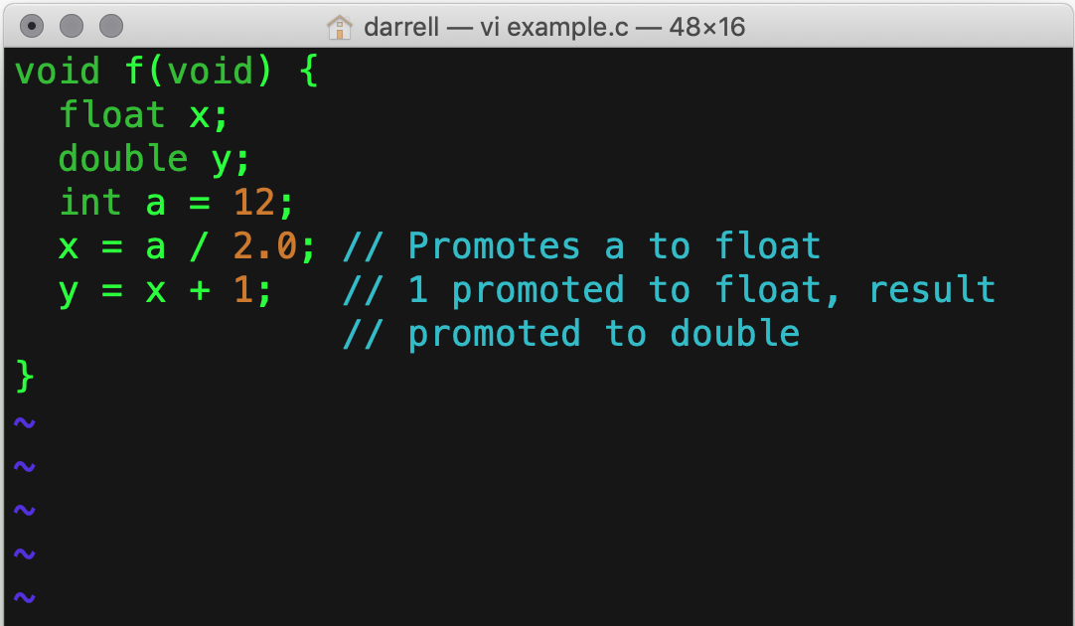
Type Promotion
When you have an expression of mixed types, then C will promote the lower type to a higher type.
Lower means that values of that type are a subset of the values that can be held by the higher type.
Smaller integers are promoted to bigger integers.
Integers are promoted to floating point types.
Smaller floating point types are promoted to larger floating point types.

Slide 35
Operator Precedence
Operators | Associativity
* / % | Left
+ - | Left
<< >> | Left
< <= > >= | Left
== != | Left
& | Left
^ | Left
| | Left
&& | Left
|| | Left
?: | Right
= += -= *= /= %= … | Right
Operators fall into equivalence classes: for example multiplicative, additive, logical, Boolean, and bit-wise operators.
There are more operators than are shown in this table.
If you are unsure of precedence or associativity then use () to make your expression unambiguous.

Slide 36
Summary
Computers work with bits (0 and 1), and
These bits are grouped in bytes (8 bits),
These bytes group into larger quantities called words.
Computers do integer arithmetic in finite fields,
Because the words are of fixed size.
This allows us to use two’s complement arithmetic.
Computers can only represent a small subset of the integers.
Computers give us data types like: float, double, and long double.
Do not make the mistake of thinking they are real numbers (ℝ),
They are really a very small subset of the rationals (ℚ).
Ultimately, do we care how computers represent numbers? Usually, we do not. But, we do care when (i) we want to manipulate bits, and (ii) when we care about precision, as in scientific calculations. We must always choose a representation that can hold all the values that we need.

